Slide 1


Cryptanalytic Techniques
for Sequence Generators with Cryptographic Application
LI Bin
blias@connect.ust.hk
Dec. 2016

Slide 2
01
INTRODUCTION
CONTENTS
02
PRELIMINARIES
03
TECHNICAL CONTRIBUTIONS
04
DETAILED DESCRIPTION OF THE RESULTS

Slide 3
01
INTRODUCTION

Slide 4
Linear Feedback Shift Register (LFSR)
X⁴+X+1
Primitive polynomial
0
0
0
0
1
1
1
0
1
1
T_{max}=2^{L}-1
2⁴-1=15
X⁰
X¹
X²
X³
X⁴
0
0
0
1
1
0
0
1
1
0
0
0
1
1
1
1
1
1
0
0
000111101011001...
1
1
1
1
1
1
1
0
0
1
PN sequence
(Pseudo-Noise sequence)
1
1
1
1
0
0
0
0
1
0
1
1
1
0
1
0
0
1
0
0
1
1
0
1
0
1
1
0
0
0
0
0
1
0
1
0
0
0
0
1
Notes:
The procedure of sequence generation is very dynamic.
LFSR has many cells. we determine the initial states so it can output binary sequence.
For every LFSR, it has corresponding representative polynomial.
polynomial with longest period represented by expression 2^{L}-1, where L is the degree of the polynomial, could be called primitive polynomial.

Slide 5
Design of binary cipher sequence
Pseudorandom
sequence
01101001
10111010
Original
message
Ciphered message
11010011

Slide 6
Shrinking Generator
Shrinking generator is combined with two linear feedback shift registers. Each of them can generate PN sequence. Two registers with different degrees can generate keystream sequence with good randomness properties.
R1:
1 0 1 0 0 1 1 1 0 0 1 1...
The decimation rule is:
when the bit of R1 is 1, the corresponding bit of R2 is selected, otherwise the bit of R2 is rejected.
R2:
0 1 1 1 1 0 0 0 1 1 0 1...
0
1
0
0
0
0
1
Keystream sequence

Slide 7
Other Generators ( one LFSR )
0
0 1 1 1 0 0 1 0 1 0 1 0 0 0 1 1 1 0
1
1
0
1
0
Self-shrinking Generator
(0 1) (1 1 ) (0 0) (1 0 ) (1 0 ) (1 0 ) (0 0) (1 1 ) (1 0 )
(0 0 1) (1 1 1 ) (0 1 0) (1 0 0 ) (1 1 0 ) (1 0 0 ) (0 0 0) (1 1 1 ) (1 0 0 )
Modified Self-shrinking Generator
0
0
0
0
0 1 1 1 1 0 1 0 1 0 0 1 1 0 1 0 0 0 0 0 1 1 1 1 0 0 0
1 1 1 1 0 1 0 1 0 0 1 1 0 1 0 0 0 0 0 1 1 1 1 0 0 0 0
0 0 1 1 1 1 0 1 0 1 0 0 1 1 0 1 0 0 0 0 0 1 1 1 1 0 0
Generalized Self-shrinking Generator

Slide 8
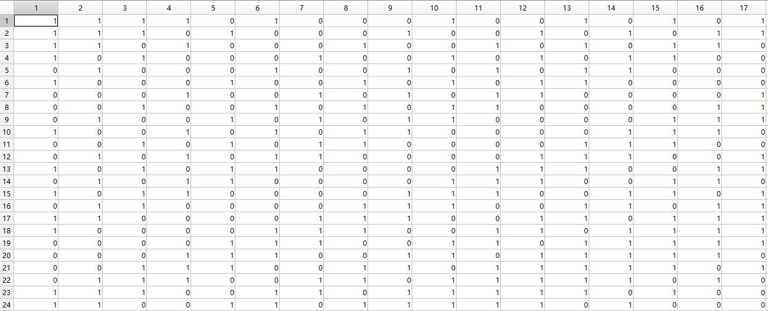
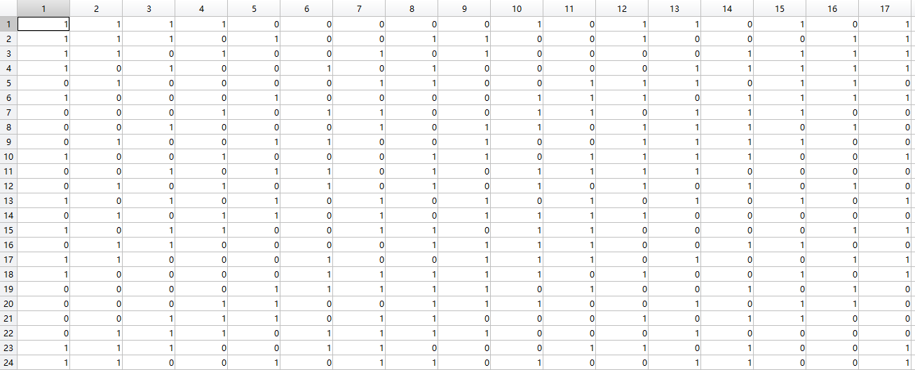

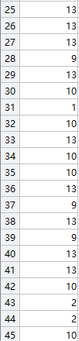
Generalized Self-shrinking Generator

Slide 9
02
PRELIMINARIES

Slide 10
Cryptanalysis ( Shrinking Generators )
Cryptanalysis of shrinking generators aims to recover the initial states of both registers. Because initial states of both registers are the key of the cryptosystem.
Known factors: Two registers of shrinking generators with different lengths , structure of two registers, intercepted bits from keystream sequence, P(x), Zech logarithm.
Output: number of correct initial states of R1.
System of Linear
Equations
Initial state of R2
Notes:
It is simple to generate a sequence. The difficult part is to recover the sequence.

Slide 11
Z_{ɑ}(n)=log_{ɑ}(1+ɑ^{n})
ɑ^{Z(n)}=1+ɑ^{n}
Cryptanalysis ( Zech Logarithm )
R1:
1
0
0
1
1
1
0
1
0
0
1
0
R1:X³+X²+1
pos:
0
3
4
5
7
10
1
2
R2:X⁴+X³+1
(L1=3,L2=4)
2^{L1}-1=7=T1,
2^{L2}-1=15=T2
P(x):X⁴+X+1
(d*T1) mod ( T2)=1, d=13
pos1=(pos*d) mod (T2)
3
ɑ⁰=1
ɑ¹=ɑ
ɑ²=ɑ²
ɑ³= ɑ³
ɑ⁴=ɑ+1
4
5
pos1:
0
9
7
5
1
10
6
0
0
1
1
7
1
0
0
1
1
1
0
Intercepted bits:
0
ɑ⁵=ɑ²+ɑ
8
ɑ⁶=ɑ³+ɑ²
ɑ⁷=ɑ⁴+ɑ³=
ɑ³+ɑ+1
ɑ⁸=ɑ²+1
ɑ⁹=ɑ³+ɑ
ɑ¹⁰=ɑ²+ɑ+1
ɑ¹¹=ɑ³+ɑ²+ɑ
ɑ¹²=ɑ³+ɑ²+ɑ+1
ɑ¹³=ɑ³+ɑ²+1
ɑ¹⁴=ɑ³+1
ɑ¹⁵=1
pos2:
?
15
13
2
9
7
8
Z_{ɑ}(9−7)+7=
Z_{ɑ}(2)+7=
Z_{ɑ}(1+ɑ²）+7=
8+7=
15
10
Intercepted bits:
1
0
1
1
0
1
1
1
Z_{ɑ}(0−9)+9=
Z_{ɑ}(-9+15)+9=
Z_{ɑ}(1+ɑ⁶）+9=
Z_{ɑ}(ɑ³+ɑ²+1)+9=
13+9=22=
22-15=7
1
11
12
Contradiction found
13
Higher Degrees?
14
15
Notes:
p(x) is a

Slide 12
Cryptanalysis ( Shrinking Generators )
Zech Log of p(x):
ɑ⁽⁰⁾
ɑ⁽¹⁾
ɑ⁽²⁾
ɑ⁽³⁾
.
.
.
ɑ^{(n)}
ɑ^{(n+1)}
.
.
.
ɑ⁽¹⁰⁴⁸⁵⁷⁵⁾
ɑ⁽¹⁰⁴⁸⁵⁷⁶⁾
The most time consuming part is the computation of Zech logarithm. With the increase of the degrees of polynomials, the number of Zech logarithm set will increase exponentially. If the degree of polynomial p(x) is 20, the number of the set will be 2²⁰, which is 1048576. That is to say Zech logarithm has to do exhaustive search for 10⁶ times in average to get one assigning position.
2¹⁶-1=65535
>>ZechLog_16_17(14093 , 17843)
Elapsed time is 9.846393 seconds.
input1
input2

Slide 13
03
TECHNICAL CONTRIBUTIONS

Slide 14
Initial States Selection
R1:
1
0
0
1
1
1
0
1
0
0
1
1
1
0
1
pos:
0
3
4
5
7
R1:
1
0
0
1
1
1
0
1
0
0
1
1
1
0
1
pos:
0
1
2
4
7
8
9
11
R1:
1
0
0
1
1
1
0
1
0
0
1
1
1
0
1
pos:
0
1
3
6
7
8
10

Slide 15
Avoid Zech Logarithm Computation
0
0
0
0
Zech Log(x^{n-1},x^{n})=10
1
1
2
2
3
3
4
4
1
1
1
5
5
6
6
7
7
8
8
0
0
9
9
10
10
11
11
12
12
13
13
14
14
15
15
Notes:
last one Zech logarithm

Slide 16
Technical Contributions
Use functions
instead of scripts
Generate variables
in advance
Save data
automatically
Preallocation of Matrix
Functions use ‘fake code’ loading parameters only once while scripts load intermedia parameter all the time.
Some variables such as intercepted bits, initial states, the set of Zech logarithm could be generated in advance.
Data should be saved after a long processing time in case some accidents happen. So new processing can start from the middle.
The matrix of this program is inside a big loop. Pre-allocation of large matrix can save memory from allocating different size to the matrix from time to time.

Slide 17
Technical Contributions
clear
tic
n = 10^4;
fcn = cell(1,n);
for ii = 1:n
fcn{ii} = @(x)x+ii;
end
toc
Elapsed time is 9.267365 seconds.
Preallocation of Matrix
a(1) = 1;
b(1) = 0;
for k = 2:8000
a(k) = 0.99803 * a(k-1)-0.06279 * b(k-1);
b(k) = 0.06279 * a(k-1) + 0.99803 * b(k-1);
end
Elapsed time is 0.013306 seconds.
Save data
automatically
function main
clear
tic
n = 10^4;
fcn = cell(1,n);
for ii = 1:n
fcn{ii} = @(x)x+ii;
end
toc
Elapsed time is 1.318399 seconds.
Generate variables
in advance
a=zeros(1,8000); %Preallocation
b=zeros(1,8000);
a(1) = 1;
b(1) = 0;
for k = 2:8000
a(k) = 0.99803 * a(k-1)-0.06279 * b(k-1);
b(k) = 0.06279 * a(k-1) + 0.99803 * b(k-1);
end
Elapsed time is 0.000753 seconds.
Use functions
instead of scripts

Slide 18
04
DETAILED DESCRIPTION OF THE RESULTS

Slide 19
Simulation Results

Slide 20
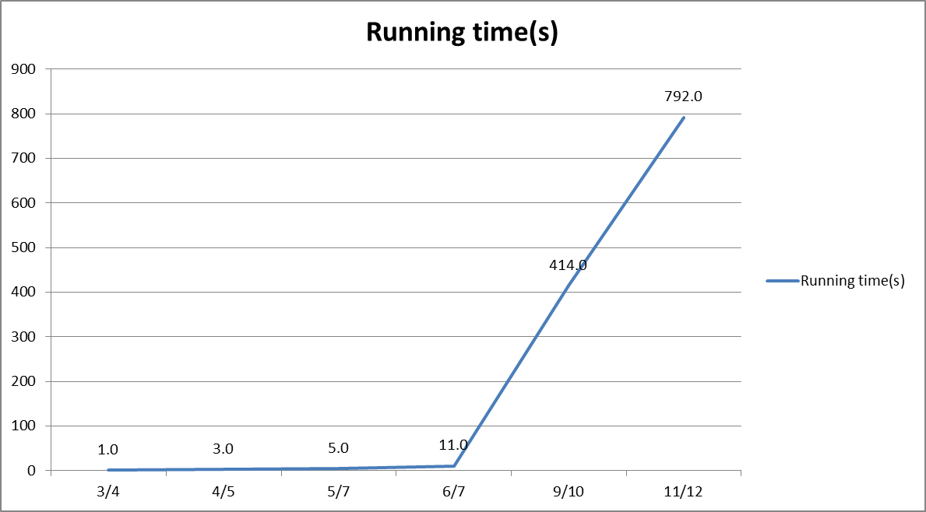
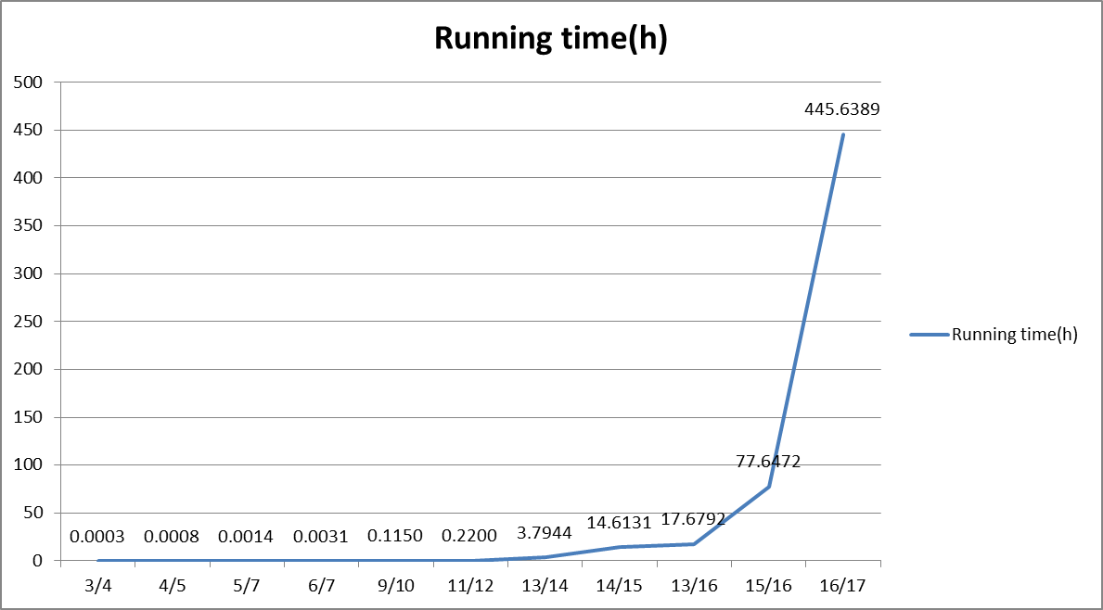
Running Time
Degrees of register pair

Slide 21
Conclusions
So far, the best a computer can process is the degree pair 16/17. The processing time is 18 days, with the size of Zech Logarithm being 2¹⁶ (65536). In the future, I would like to optimize the program in order to accelerate the processing time and run it more efficiently. If a more powerful computer is available, an analysis of higher degree could be possibly finished.

Slide 22
05
PERSONAL COMMENTS

Slide 23
Personal Comments
TITLE HERE | CHECK
Title here
Title here
Title here
Title here
Title here
Title here
Title here
01
点击此处添加标题
looking for teamwork.
pattern.

Slide 24
Personal Comments
点击此处添加标题
标题数字等都可以通过点击和重新输入进行更改，顶部“开始”面板中可以对字体、字号、颜色、行距等进行修改。建议正文8-14号字，1.3倍字间距。标题数字等都可以通过点击和重新输入进行更改，顶部“开始”面板中可以对字体、字号、颜色、行距等进行修改。建议正文8-14号字，1.3倍字间距。
点击此处添加标题
点击此处添加标题

Slide 25
Personal Comments
点击此处添加标题
点击此处添加标题
点击此处添加标题
标题数字等都可以通过点击和重新输入进行更改，顶部“开始”面板中可以对字体、字号、颜色、行距等进行修改。
标题数字等都可以通过点击和重新输入进行更改，顶部“开始”面板中可以对字体、字号、颜色、行距等进行修改。
标题数字等都可以通过点击和重新输入进行更改，顶部“开始”面板中可以对字体、字号、颜色、行距等进行修改。

Slide 26
Q & A

Slide 27
THANK YOU!

Slide 28
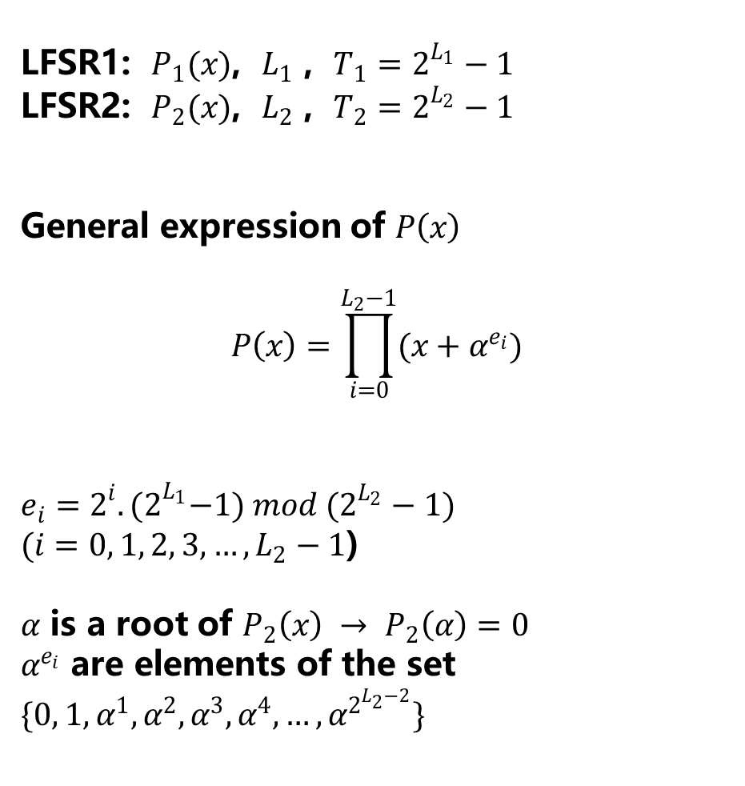
LFSR1: $P_{1}(x)$, $L_{1}$ , $T_{1}=2^{L_{1}}−1$
LFSR2: $P_{2}(x)$, $L_{2}$ , $T_{2}=2^{L_{2}}−1$
General expression of $P\left(x\right)$
$$P\left(x\right)=\prod_{i=0}^{L_{2}−1}{(x+α^{e_{i}})}$$
$e_{i}=2^{i}.{(2}^{L_{1}}−1) mod (2^{L_{2}}−1)$
$(i=0, 1, 2, 3, …, L_{2}−1$)
$α$ is a root of $P_{2}\left(x\right) → P_{2}\left(α\right)=0$
$α^{e_{i}}$ are elements of the set $\{0, 1,α^{1}, α^{2}, α^{3}, α^{4}, …, α^{2^{L_{2}−2}}\}$
Reference of P(x)

